Slide 1
CS 4530: Fundamentals of Software Engineering Module 03 Best Practices for Effective Programmers
Adeel Bhutta, Mitch Wand
Khoury College of Computer Sciences
© 2023 Released under the CC BY-SA license

Slide 2
Learning Objectives for this Lesson
By the end of this lesson you should be able to:
Describe the purpose of our best practices
List 5 principles for designing readable code, with examples
Identify some violations of the practices and suggest ways to mitigate them
Notes:
<Read Slide>

Slide 3
Use Design As a Way of Communicating Organization
Software systems must be comprehensible by humans
Which humans?
The other members of your team
The folks who will maintain and modify your system
Management
Your clients
and ...
You, a week from now or 6 weeks from now
Notes:
To put this in context, Design is the SE activity before coding. There is a saying in SE that goes like this: “Design is not coding, coding is not design”. Design is a critical part of your SE process.
<Read slide>

Slide 4
Use Design to Control Complexity
Software systems must be comprehensible by humans
Why? Software needs to be maintainable
continuously adapted to a changing environment
Maintenance takes 50–80% of the cost
Why? Software needs to be reusable
Economics: cheaper to reuse than rewrite!
4
Notes:
<Read Slide>
A relevant question here often is, what are qualities of a good design? Mitch Kapor (Lotus123) says that “good design must exhibit firmness, commodity and delight.

Slide 5
Three Scales of Design
The Structural Scale
key questions: what are the pieces? how do they fit together to form a coherent whole?
The Interaction Scale
key questions: how do the pieces interact? how are they related?
The Code Scale
key question: how can I make the actual code easy to test, understand, and modify?
Notes:
<Read Slide>
Remember that Design is often an iterative process. Design may happen at all these scales at once.

Slide 6
Today’s topic: design principles at the code scale
The Structural Scale
key questions: what are the pieces? how do they fit together to form a coherent whole?
The Interaction Scale
key questions: how do the pieces interact? how are they related?
The Code Scale
key question: how can I make the actual code easy to test, understand, and modify?

Slide 7
Coupling is the biggest source of complexity at the code level
Two pieces of code are coupled if a change in one demands a change in the other.
A coupling represents an agreement between the two pieces of code.
They may agree on:
names
order (e.g. of arguments)
meaning (e.g. meaning of data)
algorithms
The more two pieces of code are coupled, the harder they are to understand and modify: you have to understand both to understand either of them.
There's a fancy word for this: connascence (meaning "born together")
More coupling means less readability, less modifiability
Notes:
<Read slide>

Slide 8
Five general-purpose design principles
Five General Principles
1. Use Good Names
2. Make Your Data Mean Something
3. One Method/One Job
4. Don't Repeat Yourself
5. Don't Hardcode Things That Are Likely To Change
Notes:
Here are five general-purpose principles that apply to just about all programming tasks. We’ve phrased this in terms of programming practices: things that you can do to make your code better.
I suggest that you make a sticky note with this list and keep it on your laptop screen or somewhere in your workspace so that you will be constantly reminded of it.

Slide 9
Principle 1. Use Good Names
The name of a thing is a first clue to the reader about what the thing means.
often, it's the only clue ☹
Use good names for
constants
variables
functions/methods
data types
Notes:
<Read Slide>

Slide 10

Use Good Names for Variables and Types
const t : number
const l : number
const temp : number
const loc : number
const temp : Temperature
const loc : SensorLocation
Notes:
What do these variables mean?
Better names would give the reader a clue
<click>
This is a little better. But does 'temp' mean 'temporary', or 'temperature', or something else?
<click>
Better names for the data types would be even better. We’ll say more about this in a minute, when we get to Principle 2: Make Your Data Mean Something

Slide 11
Use Good Names for Functions and Methods
function checkLine (line) : boolean
function lineIsTooLong (line) : boolean
Notes:
What are you checking it for? Length? Illegal Syntax? or what?
<click>
Ahh, now we know!

Slide 12
Use Good Names for Functions and Methods
Use noun-like names for functions or methods that return values, e.g.
not:
Reserve verb-like names for functions or methods that perform actions, like
const c = new Circle(initRadius)
const a = c.diameter()
const a = c.calculateDiameter()
table1.addItem(student1,grade1)
Notes:
In the real world, your workplace should have coding standards for things like this
In this course, these conventions are part of our official coding standards.
When you work on your team project, you may want to decide about the coding conventions you will use.

Slide 13
Principle 2. Make Your Data Mean Something
You need to do three things:
Decide what part of the information in the "real world" needs to be represented as data
Decide how that information needs to be represented as data
Document how to interpret the data in your computer as information about the real world
Notes:
“Make Your Data Mean Something” What does that mean? It means that when you design your data, you need to do three things: <read bullets>

Slide 14
Example:
Right now I am wearing a red shirt, and I've decided I need to represent that fact in my program.
How should I represent that in my program?
We need to decide:
how to represent shirts (including their color)
how to represent colors
how to represent my shirt
Notes:
<read slide>

Slide 15
We need to write something like this:
type Shirt = {
/** the color of the shirt */
color: Color
}
type Color = { ... } // `red` is defined in here
/** My shirt */
let myShirt: Shirt
myShirt.color = red
Notes:
We need to define a type Shirt, which will be the data type that represent shirts. Inside that data type, there will be a field called color, and we need to record the fact that this field represents the color of the shirt.
We need to define a type Color, which will be the data type for representing colors, including the representation for red.
And when we need to represent my shirt, we’ll define a variable myShirt, and we need to record the fact that this constiable contains a representation of my shirt.

Slide 16
The Big Picture
How do we know that these are connected?
Answer: we have to write it down.
In our Typescript infrastructure, we do that with the comments.
representation
My shirt is red
type Shirt = {
/** the color of the shirt */
color: Color
} type Color = { ... }
/** My shirt */
let myShirt: Shirt
myShirt.color = red
interpretation
Notes:
Here’s the big picture. On the left, we have a fact about the real world: my shirt is red.
On the right, we see how that real-world fact is represented in our code.
We *represent* a real-world fact in code
We *interpret* the code as a real-world fact.
How do we know these are connected? We have to *write it down*.
Otherwise the next person who looks at this code won’t know what we meant.
In our Typescript system, we do that in the comments.

Slide 17
Another Example: what do (x,y) mean?
representation
export interface BoundingBox {
x: number;
y: number;
width: number;
height: number;
};
???
interpretation
The center?
Upper-left-hand corner?
Does y grow in the up or down direction?
And what about the units?
(Pixels? Scaled pixels? Something else?)
Notes:
You’ve already run across the importance of writing down the interpretation.
In this example, what do x and y mean?
<build through 5 animations>
Just count the number of questions about this on Piazza!!

Slide 18
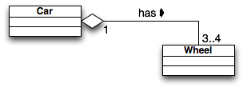
Another example: What does an object represent?
What does an object of class Car represent?
a model of car (e.g. Dodge, Ford, Toyota)?
a particular car (my 2019 Toyota, VIN = 456789)?
What does an object of class Wheel represent?
a model of tire? (Goodyear GoodGrips14)
a particular tire? (Goodyear GoodGrips14 SN = 345678)
What does "has" represent?
depends on what Car and Wheel represent
this may affect the navigability of the association
(can you get from a car object to the associated wheels? Can you get from a wheel to the car that it’s on?)
Notes:
Here’s another example.
<read slide, and click 3 times to view the whole animation>
Note that this UML diagram gives us some information about this: it says that each wheel object is “had” by exactly one car object.
But this is pretty well-hidden. It would have been helpful if the person who wrote this UML documented exactly what they meant..

Slide 19
Principle 3: One Method/One Job
Each class, and each method of that class, should have one job, and only one job
If your method has more than one job, split it into 2 methods. Why?
You might want one part but not the other
It's easier to test a method that has only one job
You call both of them if you need to.
or write a single method that calls them both
Same thing for classes.
Notes:
<Read slide>
The fancy name for this is "The Single Responsibility Principle". You can use this if you want to impress your coop interviewer.

Slide 20
Principle 4: Don't Repeat Yourself
If you have some quantity that you use more than once, give it a name and use the name.
That way you only need to change it in one place!
And of course you should use a good name
If you have some task that you do in many places, make it into a procedure.
If the tasks are slightly different, turn the differences into parameters.
Notes:
If you have some quantity that you use more than once, give it a name and use the name.
That way you only need to change it in one place!
If you have some task that you do in many places, make it into a procedure.
This is called "Single Point of Control"
And of course you should use a good name

Slide 21
A real example
function testequal <T> (testname: string, actualVal: T, correctVal: T) {
test(testname, () => { expect(actualVal).toBe(correctVal) })
}
describe('tests for countOfLocalMorks', function () {
testequal('empty crew',countOfLocalMorks(ship1),0)
testequal('just Mork',countOfLocalMorks(ship2),1)
testequal('just Mindy',countOfLocalMorks(ship3),0)
testequal('two Morks',countOfLocalMorks(ship4),2)
testequal('drone has no Morks',countOfLocalMorks(drone1),0)
})
Notes:
Here’s an actual example, from a couple of semesters ago, in Jest..
Think of how much typing this saves!
Plus, if I ever need to change what testequal does, I can do it all in one place.
Note: Jest has a built-in abstraction for this, called test.each , but that’s not the point of this example.

Slide 22
Principle 5: Don't Hardcode Things That Are Likely To Change
General strategy: If there something that might change, give it a name
if it's not already a "thing", refactor to make it a "thing“
Let’s look at a couple of examples.
Notes:
<read slide>

Slide 23
Replace magic numbers with good names
Replace magic numbers with good names
const salesprice = netPrice * 1.06
const salesTaxRate = 1.06
const salesPrice = netPrice * salesTaxRate
Notes:
Where did that 1.06 come from?
Oh, it's the sales tax? Are there many occurrences of that 1.06 in your code? (Probably!) Will the sales tax rate ever change? (Probably!)
const's fix it!<click>

Slide 24
Example
Imagine we are computing income tax in a state where there are four rates:
One on incomes less than $10,000
One on incomes between $10,000 and $20,000
One on incomes between $20,000 and $50,000
One on incomes greater than $50,000
You might write something like
Notes:
<You can skip this example if you are worried about time>
Here’s another example:
<read slide>

Slide 25
You might write something like
What might change?
The boundaries of the tax brackets might change
The number of brackets might change
function grossTax(income: number): number {
if ((0 <= income) && (income <= 10000)) { return 0 }
else if ((10000 < income) && (income <= 20000))
{ return 0.10 * (income - 10000) }
else if ((20000 < income) && (income <= 50000))
{ return 1000 + 0.20 * (income - 20000) }
else { return 7000 + 0.25 * (income - 50000) }
}
Notes:
Here’s a possible piece of code.
Here we’ve hard-coded the information about the tax brackets.
But those might certainly change. What might change?
The boundaries of the tax brackets might change
The number of brackets might change.
This tells us that the notion of a “tax bracket” is an important concept.
But this concept is not explicit in the code we’re looking at– it’s hard-wired into the code.
So probably we should have a representation of “a tax bracket” as a piece of data.
And once we realize that “tax bracket” is an important concept, we can also see that this piece of code violates One Function/One Job:
It finds the appropriate bracket AND calculates the appropriate tax.

Slide 26
So let's represent our data differently
// defines the tax bracket for income lower < income <= upper.
// if upper is undefined, then lower < income (no upper bound)
type TaxBracket = {
lower: number,
upper: number | undefined,
base : number
rate : number
}
const brackets : TaxBracket[] = [
{lower:0, upper:10000, base:0, rate:0},
{lower:10000, upper:20000, base:0, rate:0.10},
{lower:20000, upper:50000, base:1000, rate:0.20},
{lower:50000, upper: undefined, base:7000, rate:0.25}
]
Notes:
So here’s a possible representation of a tax bracket. Note the comment on the first two lines, which tells us what a value of type TaxBracket means in the real world.
Among other things, we now have a single point of control if we ever need to change the brackets.

Slide 27
And now it's easy to rewrite our function
// defines the incomes covered by a bracket
function isInBracket(income:number, bracket:TaxBracket) : boolean {
if (bracket.upper === undefined)
{ return (bracket.lower <= income) }
else
{ return ((bracket.lower <= income) && (income < bracket.upper))}
}
function income2bracket(income: number, brackets: Bracket[]): Bracket {
return brackets.find(b0 => isInBracket(income, b0))
}
function taxByBracket(income:number,bracket:TaxBracket) : number {
return bracket.base + bracket.rate * (income - bracket.lower)
}
function grossTax2 (income:number, brackets: TaxBracket[] ) : number {
return taxByBracket(income,income2bracket(income,brackets))
}
Notes:
So here’s our rewritten code. And we are back to one function/one job.
Professor Wand says: “True story: My first draft of this code was quite different and had several bugs. I eventually located the bugs by rewriting the code with one function/one job. When I did that, it was easy to see which part was broken.”
Discuss: We now have three specifications of a bracket: one on Slide 24, one on Slide 25, and one here on Slide 27 (as isInBracket). Do these specifications agree? What could go wrong?
What assumptions does income2bracket make about the list brackets? Hints: is every possible list of brackets a legal representation of some tax table? How could you define a bracket list that would cause income2bracket to return the wrong thing? Where should we record these assumptions? Would it help to define a type called TaxBracketList ?

Slide 28
Review: Learning Objectives for this Lesson
You should now be able to:
Describe the purpose of our best practices
List 5 principles for designing readable code, with examples
Identify some violations of the practices and suggest ways to mitigate them

Slide 29
Additional Material

Slide 30
Examples of Design at the Structural Scale
Object-Oriented
Pipeline
Pipeline + Database
Layered
Notes:
<Cover if time>
This lesson has been about design at the code level. Here’s some brief introduction to the other two scales, starting with top level, also sometimes called Architecture level.
<read slide>
Although we will cover just a few, there are many more: like Plug-in architecture (firefox, vsc), event-driven architectures (android, mobileOS), P2P (Zelle, bitTorrent), Microservices (Firefox). Many modern large scale systems are now heterogeneous (i.e., combination of many)

Slide 31
Object-Oriented Architecture
The entities in the program correspond to entities in the real world.
Example: a library system might have classes for
A holding (several books, eg: “7 copies of Moby-Dick”)
An individual item (“copy #3 of Moby-Dick”)
A card-holder (“Avery Fischer, library card #12345, …”)
A borrowing (“Avery Fischer borrowed copy #3 of Moby-Dick on 9/1/22”)
Notes:
Our first architectural style is the object-oriented architecture. In this architecture, the pieces of the program correspond to entities in the real world, and the properties and operations correspond to properties and operations of the corresponding real-world objects.
For example, in a library catalog system, we might have…<read slide>. The most important thing is to make sure that you document exactly what each of your classes represent.
This is not about the language technology that we use to implement the system. We could conceivably implement an object-oriented architecture using a language that was not itself object-oriented.

Slide 32
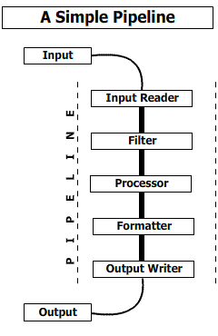
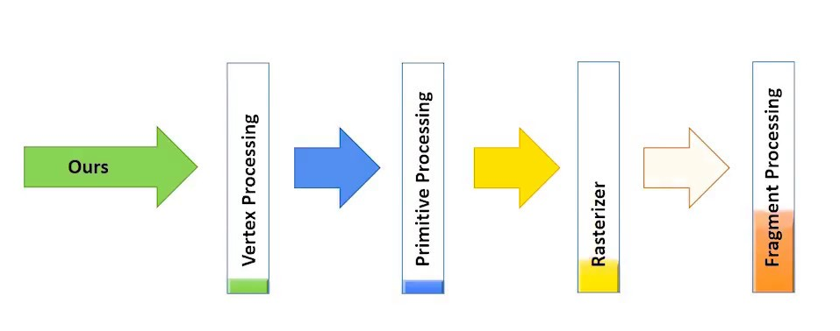
Pipeline Architecture
The pieces correspond to stages in the transformation of data in the system
Good for complex straight-line processes, e.g. image processing
Notes:
Pipelines are a third kind of architecture. Here, the pieces correspond to steps in the transformation of some data. Each piece depends on the data produced by the preceding piece.

Slide 33
Pipeline + Database
Stages in the pipeline share data through a database
database
Notes:
Pipelines are a third kind of architecture. Here, the pieces correspond to steps in the transformation of some data. Each piece depends on the data produced by the preceding piece.

Slide 34
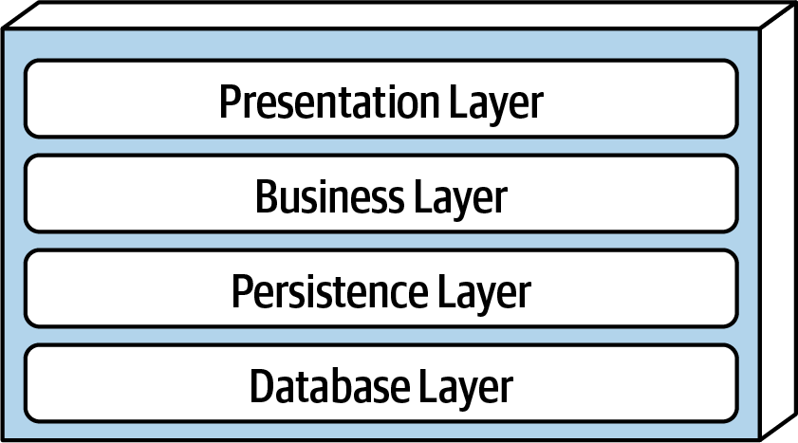
Layered Architecture
Request
Response
The pieces correspond to level of concern.
Each layer depends on services from the layer or layers below
Data/Control Flow
Notes:
Here is a layered architecture. In a layered architecture, the pieces correspond to levels of concern, where each layer depends on services from the layer or layers below. This is an example of “Separation of Concerns.” For example, the Presentation Layer depends only on the data supplied by the Business Layer; it does not have to concern itself with the details of how that data is computed.
One advantage of this architecture is that the different layers typically require different areas of expertise, so in a large project one might have separate teams for each layer.
Remember that each Layer may have its own internal architecture. For example, the Presentation Layer may itself be implemented using an object-oriented architecture.

Slide 35
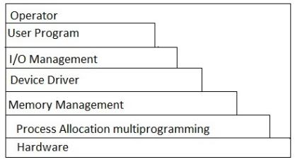
Layered Architecture (contd)
Typical organization for operating systems
Layers communicate through procedure calls and callbacks (sometimes called "up-calls")
Notes:
Layered architectures are very common in Operating Systems. You’ve probably seen pictures like this in your Operating Systems class.

Slide 36
Design at the Interaction Scale
Roughly what’s typically called “Design Patterns”
We’ll talk about some OO Design Patterns in the next lecture.
But we’ll see interaction-scale patterns in many domains, not just OOP.

